Slide 1
MOAT ACADEMY FOR DEVELOPERS
WEB APPLICATION DEVELOPMENT TRAINING
Designing Responsive websites with Bootstrap 5.x

Slide 2
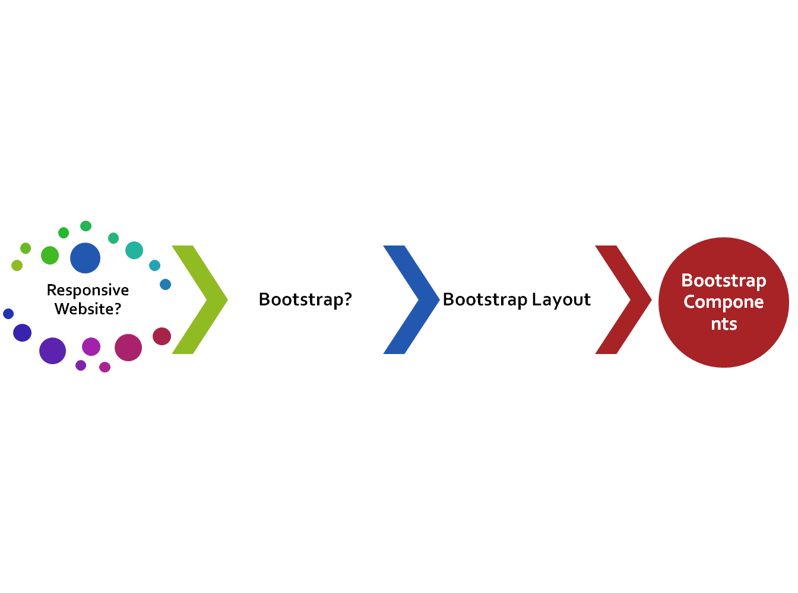
CLASS
OUTLINE

Slide 3

What is a Responsive Website?
Responsive websites are websites that can adapt to the screen of any device…
The site displays properly on various devices without the need to scroll sideways

Slide 4
What is Bootstrap?
Bootstrap is a collection of ready-made CSS files (and JavaScript) that can be used in designing web interfaces.
It is a frontend development framework that enables developers and designers to quickly build fully responsive websites.
The css rules are mostly specified within classes that can be used in your HTML file.
TASK: Open css/bootstrap.css to discover the ready-made classes
The most important problem solved by the bootstrap framework is the handling of responsiveness for you. You remember media query?

Slide 5
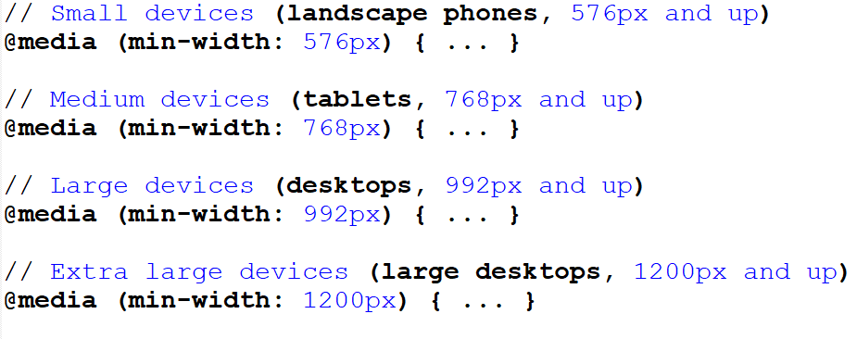
Responsive Website
Under the hood, achieving responsiveness is through media query targeting various device widths
Notes:
// Small devices (landscape phones, 576px and up)
@media (min-width: 576px) { ... }
// Medium devices (tablets, 768px and up)
@media (min-width: 768px) { ... }
// Large devices (desktops, 992px and up)
@media (min-width: 992px) { ... }
// Extra large devices (large desktops, 1200px and up)
@media (min-width: 1200px) { ... }

Slide 6
Before We Start :
Declaring a DOCTYPE : Bootstrap makes use of global styles and settings to remove the effects of cross browser anomalies. Hence always include the HTML5 doctype at the beginning of the page
Include the lang attribute in the html tag
Modify your tags to look like the following:
  <!doctype html>
  <html lang="en">
  ...
  </html>

Slide 7
Parts of a Starter Bootstrap Template
Include the following required meta tags
  <meta charset="utf-8">
  To ensure proper rendering and touch zooming for all devices, add the responsive viewport meta tag
  <meta name="viewport" content="width=device-width, initial-scale=1, shrink-to-fit=no">
Include Bootstrap CSS file
Javascript for the moving parts
  JS at the bottom is a good practice as js loads slower than css
  Since JS is for interactivity, it is safe to allow our layout loads completely before the JS.
  Can be included from the server or CDN
  Note that bootstrap.bundle.js and bootstrap.bundle.min.js include Popper (popper.min.js before bootstrap.js if you are not using bootstrap.bundle)
Notes:
<meta name="viewport" > is important when simulating the mobile view on web browser Chrome, Mozilla etc

Slide 8
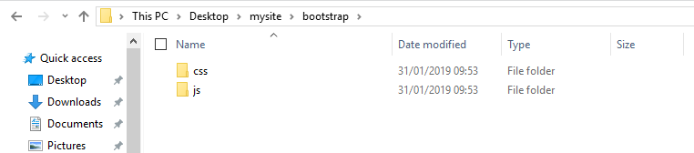
Downloaded Files

Slide 9
Device Categories : Understanding Responsive Breakpoints
Bootstrap has written sufficient media queries for certain breakpoints to ensure that your website is responsive.
Breakpoints are representative of a subset of common device sizes and viewport dimensions for devices manufacturers
The breakpoints don’t specifically target every possible device in the world, but the ranges provide a strong and consistent foundation to build on for nearly any device.
Bootstrap includes six default breakpoints, sometimes referred to as grid tiers

Slide 10
Bootstrap Breakpoints and the respective class label
Breakpoint | Class infix | Dimensions
X-Small | None | <576px
Small | sm | ≥576px
Medium | md | ≥768px
Large | lg | ≥992px
Extra large | xl | ≥1200px
Extra extra large | xxl | ≥1400px

Slide 11
BOOTSTRAP LAYOUT
The container, row and column classes
Understanding the bootstrap grid system…

Slide 12
Bootstrap Layout Overview
  Just as you have your contents enclosed within the
  <table> --- <tr> --- <td> tag when using table, the bootstrap has 3 important classes as shown below:
  <table>
    <tr><td> Contents </td></tr>
  </table>
  ---------------------------------------------
  <div class=‘container’>
    <div class=‘row’><div class=‘col’> Contents </div></div>
  </div>
  The container class serves as the div that wraps all the other contents, it also provides an appropriate padding on the page.
  The row class defines the number of rows standing on top of another in your layout
  The col (umn) class defines how many divs are standing side-by-side within a particular row.
  TASK: create a layout as above.

Slide 13
Bootstrap Layout Overview: The container class
There are three variations of the container class, namely:
.container, which sets a max-width at each responsive breakpoint
.container-fluid, which is width: 100% at all breakpoints
.container-{breakpoint}, which is width: 100% until the specified breakpoint. It stays 100% at some time and not at the specified breakpoint
.container-sm will be 100% until width is greater than or equal to 576px etc
Breakpoint | Class infix | Dimensions
X-Small | None | <576px
Small | sm | ≥576px
Medium | md | ≥768px
Large | lg | ≥992px
Extra large | xl | ≥1200px
Extra extra large | xxl | ≥1400px
Notes:
Following the syntax .container-{breakpoint} ,
Container will be 100% for anything less than 576px

Slide 14
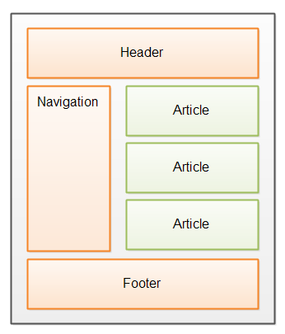
Bootstrap Layout Overview: The row class
The row class defines the horizontal sections on the page while the various variants of class col defines the columns
A given column can have as many rows to further divide it. See below:
CASE STUDY
There are 3 major rows in the container class
The second row has 2 columns
The second column has 3 rows

Slide 15

QUIZ
Bootstrap Layout Overview: The row class
QUIZ
Based on color demarcation, how many rows are there in this layout?

Slide 16
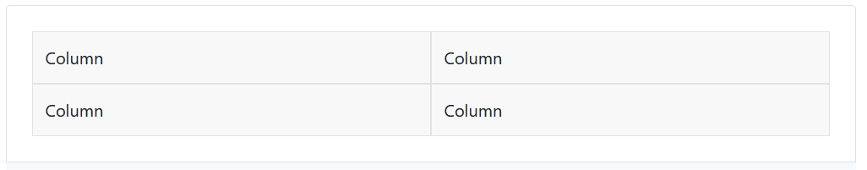
Bootstrap Layout Overview: The row class
From the row div, you can set how many columns you want to see sit side by side through the class .row-cols-* (where * is the number of columns)
For example
<div class=‘row row-cols-2‘>
  <div class=‘col’></div>
  <div class=‘col’></div>
  <div class=‘col’></div>
  <div class=‘col’></div>
</div>

Slide 17
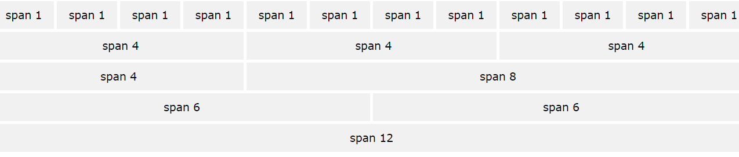
Bootstrap Layout Overview: The col (umn) class
  In defining the number of available columns; bootstrap makes use of a grid system that imaginarily divides the screen to 12 columns
  The columns will re-arrange automatically depending on the screen size.
  The column can be specified with col-Number (eg col-6) to show how many of the grids are in given column

Slide 18
We can further specify breakpoints for our columns: the point (device) at which our div’s stop standing side by side
Use col-{breakpoint}-Number
Bootstrap Layout Overview: The col (umn) class

Slide 19
Device Categories: Bootstrap Grid Classes
The Bootstrap 5 grid system has five classes:
.col- (extra small devices - screen width less than 576px)
.col-sm- (small devices - screen width equal to or greater than 576px)
.col-md- (medium devices - screen width equal to or greater than 768px)
.col-lg- (large devices - screen width equal to or greater than 992px)
.col-xl- (xlarge devices - screen width equal to or greater than 1200px)
.col-xxl- (xxlarge devices – screen width equal to or greater than 1400px)
Classes can be combined, each class scales up, setting width for sm also means md has same definition.
If the divs total more than 12, the excess will wrap over to the next line. *
You can specify more than one of these at a time to determine how a given column will appear on different devices
<div class=‘col-sm-3 col-md-2’></div>
Notes:
* This may be desirable in some situations like photo gallery, grid contents on blogs etc

Slide 20
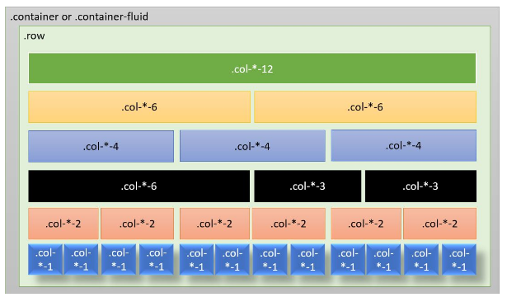
Bootstrap Grid Classes : The breaking point general formula

Slide 21
Bootstrap Grid Classes
Using .col alone without the breakpoint will handle the width automatically by creating equal width on all devices
.col-{breakpoint} will create equal columns on the target device. For example, .col-md will create equal columns on desktop devices while the columns will stack on smaller devices.
  .col-{breakpoint}-auto will resize the column based on its growing contents. You can find applicability in photo gallery.

Slide 22
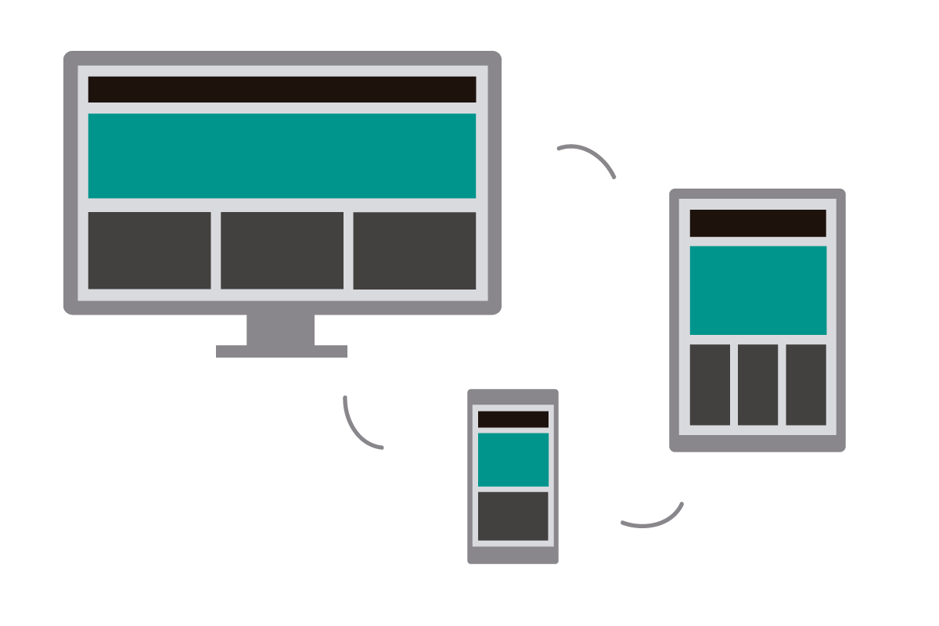
Handson: achieve the following, no need to reckon with the margin

Slide 23
Bootstrap Grid Classes
COLUMN OFFSETTING
.offset-md-* classes. These classes increase the left margin of a column by * columns. For example, .offset-md-4 moves .col-md-4 over four columns.

Slide 24
Vertical and Horizontal Alignment within the row class
In situations where your col(umn) divs do not fill up the entire width of the row div, you can set horizontal alignment using any of the following: add any of the classes to your row div
  justify-content-start
  justify-content-end
  justify-content-center
  justify-content-around
  justify-content-between
You can also set a vertical alignment if the col(umns) divs do not fill up the entire height of the row div, you can set vertical alignment using any of the following:
  align-items-end
  align-items-start
  align-items-center

Slide 25
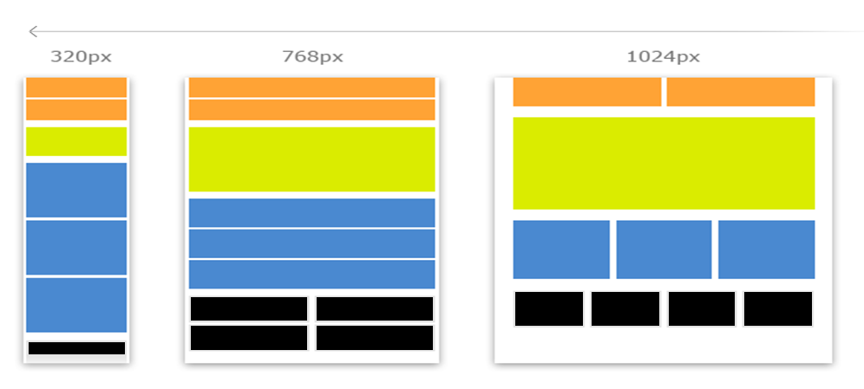
Classwork: Responsive Website Layout – Target Devices
Notes:
The grids will stack when viewed from devices that are smaller than the target device.
You can specify more than one device class for a single div

Slide 26
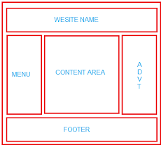
Assignment: Achieve this layout with responsiveness using bootstrap classes. Don’t bother about the spaces..

Slide 27
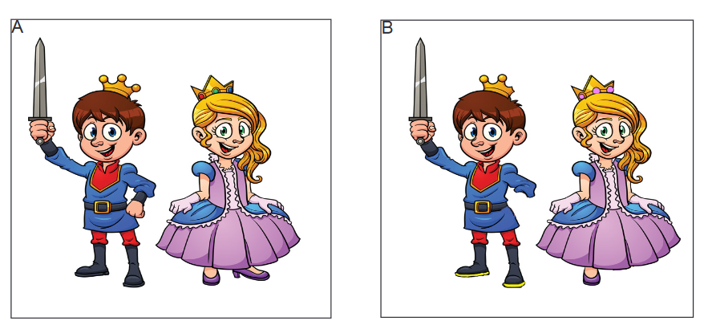
Assignment 2
Spot The difference.
There are 5 differences

Slide 28
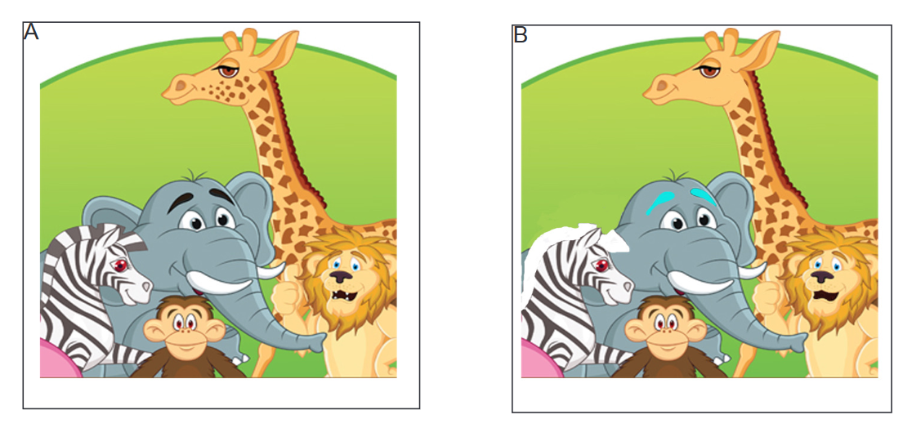
Assignment 2
Spot The difference. There are 5 differences

